Slide 1
Hardware Fundamentals
Notes:
This template can be used as a starter file for presenting training materials in a group setting.
Sections
Right-click on a slide to add sections. Sections can help to organize your slides or facilitate collaboration between multiple authors.
Notes
Use the Notes section for delivery notes or to provide additional details for the audience. View these notes in Presentation View during your presentation.
Keep in mind the font size (important for accessibility, visibility, videotaping, and online production)
Coordinated colors
Pay particular attention to the graphs, charts, and text boxes.
Consider that attendees will print in black and white or grayscale. Run a test print to make sure your colors work when printed in pure black and white and grayscale.
Graphics, tables, and graphs
Keep it simple: If possible, use consistent, non-distracting styles and colors.
Label all graphs and tables.

Slide 2
Hardware:
Computer Hardware refers to the physical parts of a computer and related devices.
Internal hardware devices include motherboards, hard drives and RAM.
External hardware devices include monitors, keyboards, Mice, printers and scanners.
Notes:
Give a brief overview of the presentation. Describe the major focus of the presentation and why it is important.
Introduce each of the major topics.
To provide a road map for the audience, you can repeat this Overview slide throughout the presentation, highlighting the particular topic you will discuss next.

Slide 3

Input Devices:
An input device is any hardware component that allows you to enter data and instructions onto a computer.
Widely used input devices are the keyboard, mouse, scanner.
Notes:
This is another option for an Overview slides using transitions.

Slide 4
Keyboard:
Keyboard connector types
1. DIN
2. USB
3. PS/2 (5 or 6 pins)
DIN type is a 5 pin connector.
USB type is hot swappable.
Compatible port for PS/2- purple or violet.
Standard Keyboard keys- 102.

Slide 5

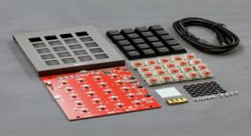
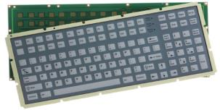
Keyboard
Mechanical Keyboard
Membrane keyboard

Slide 6

Mouse:
A Computer Mouse is a handheld hardware input device that controls a cursor in a GUI and can move and select text, icons, files, and folders.
Functions of a mouse:
1. Move the cursor
2. Open or execute program
3. Select
4. Drag-and-Drop
5. Hover
6. Scroll
7. Perform other functions etc.

Slide 7
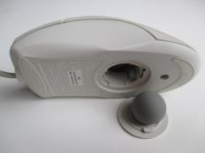
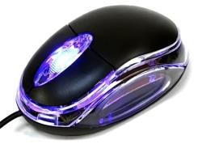
Types of Mouse
Ball Mouse
Optical Mouse

Slide 8
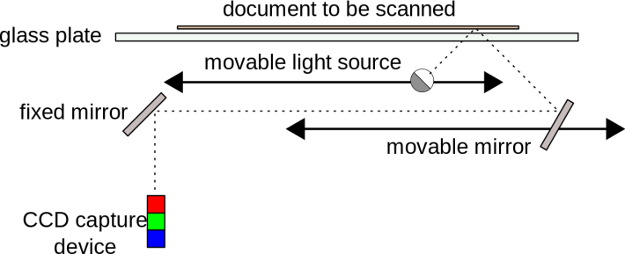
Scanner
Scanner is a device that capture images from photographic prints, posters, documents for computer editing and display.
Working Principle:

Slide 9
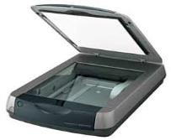



Types of Scanners
Flatbed scanner
Handheld Scanner
Sheet fed Scanner
Drum Scanner

Slide 10
Monitors:
A computer monitor is an output device which displays information in pictorial form.
Types of Monitors
CRT Monitors
LCD Monitors
LED Monitors

Slide 11
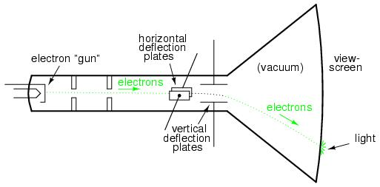
CRT(Cathode Ray Tube) Monitors:
Phosphor coated screen

Slide 12
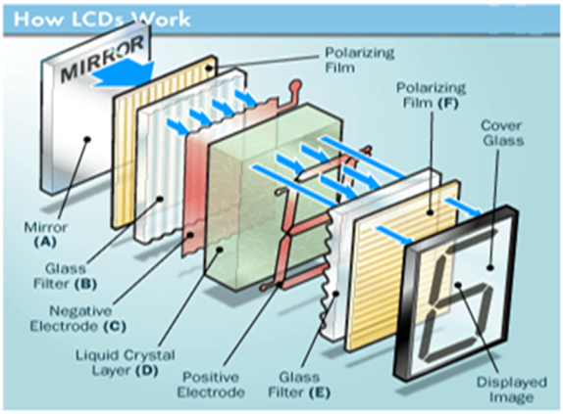
LCD Monitors:

Slide 13
Printers:
A Printer is an output device which provides output in the form of a hardcopy.
In general, more expensive printers are used for higher-resolution color printing.
Types of printers:
Impact printers.
Dot matrix printers
Non-impact printers.
Ink-Jet printers.
LASER Printers.

Slide 14
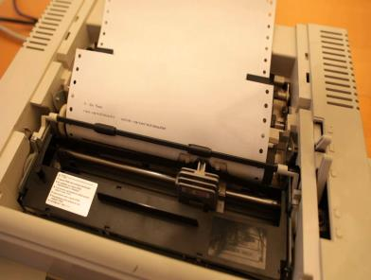
Dot Matrix printers:
Dot matrix printers is like a typewriter which uses striking mechanism.
Each individual character is formed by the arrangement of a series of pins.
It gives the printout in a characteristic “dotted” appearance.

Slide 15
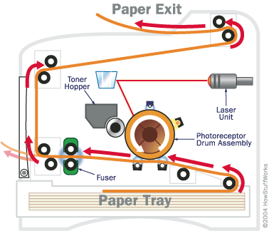
Laser Printer:
It’s a non-impact printer which uses photocopier technology for printing.
LASER printer was first introduced by IBM.
LASER printer is able print in different colors.

Slide 16
Motherboard
A motherboard is the main circuit board inside a computer that connects the different parts of a computer together directly or indirectly.
It has sockets for the CPU, RAM and expansion cards and it also hooks up to hard drives, disc drives and front panel ports with cables and wires.

Slide 17
Functions of Motherboard
The motherboard acts as the central backbone of a computer on which other modular parts are installed such as the CPU, RAM and hard disks.
The motherboard also acts as the platform on which various expansion slots are available to install other devices / interfaces.
The motherboard is also responsible to distribute power to the various components of the computer.

Slide 18
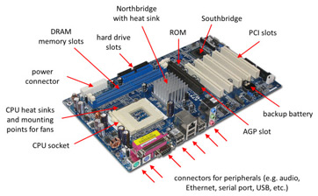
Motherboard Components and Connectors
Processor :
A processor is a logic circuitry that responds to and processes the basic instructions that drive a computer.
The four primary functions of a processor are Fetch, Decode, Execute and Display.

Slide 19
PCI SLOT (Peripheral Component Interconnect) : PCI slots are used to Insert or install Add-on cards, such as LAN cards, Sound cards, Capture cards and TV tuner cards. There are usually anywhere from 1 to 6 PCI slots available on the motherboard(above board has 2 PCI slots. ), they have decreased in number and are being replaced by the PCI Express 1x slots.
Northbridge: This allows communication between the CPU and the system memory and PCI-E slots.
Southbridge: This is the controller for components such as the PCI slots, onboard audio, and USB connections.

Slide 20
SATA Connections : SATA full form is Serial Advanced Technology Attachment. These are connected with serial ATA devices, such as Hard disk drives and CD or DVD drives.
ATX Power Connector: This is the second of two power connections. This is the main power connection for the motherboard, and comes from the Power Supply.
DIMM slots: DIMM's are by far and away the most used memory types in today's computers. They vary in speeds and standards however and they need to match up to what your motherboard has been designed to take. The four standards of DIMM's being used at the moment are SDR (Single Data Rate), DDR (Double Data Rate), DDR2 and DDR3. The speeds of memory can vary between 66Mhz to 1600Mhz .

Slide 21
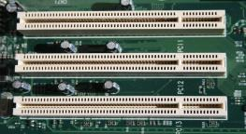
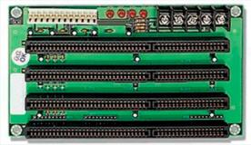
ISA (Industry Standard Architecture:(16 bit)
It allows 16 bits data at a time to flow between the Motherboard circuitry and expansion slot card
EISA ( Extended Industry Standard Architecture-32bit)

Slide 22
CMOS battery:
“Complimentary metal-oxide semiconductor”. It is an onboard, battery powered semiconductor chip inside computers that stores Bios settings.

Slide 23
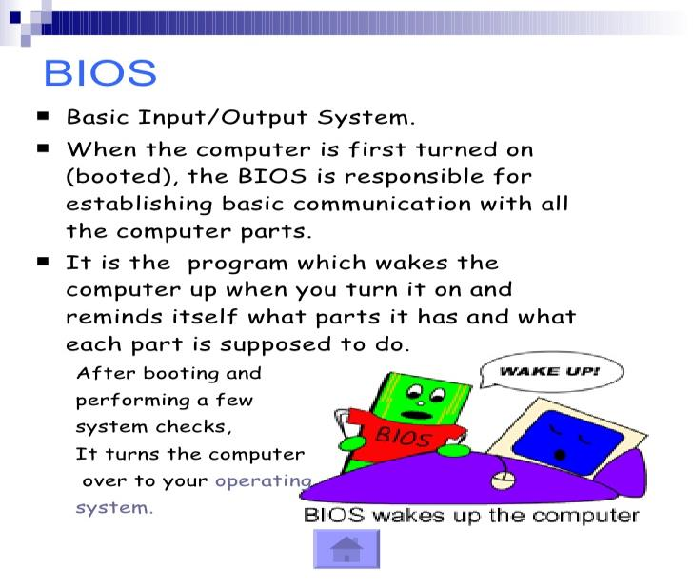

Slide 24
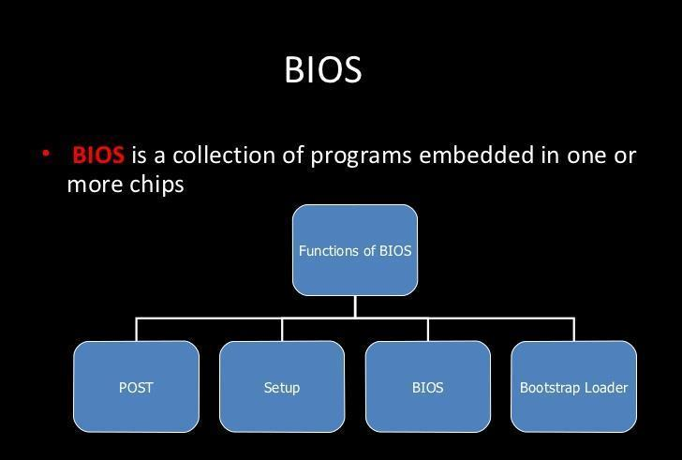

Slide 25
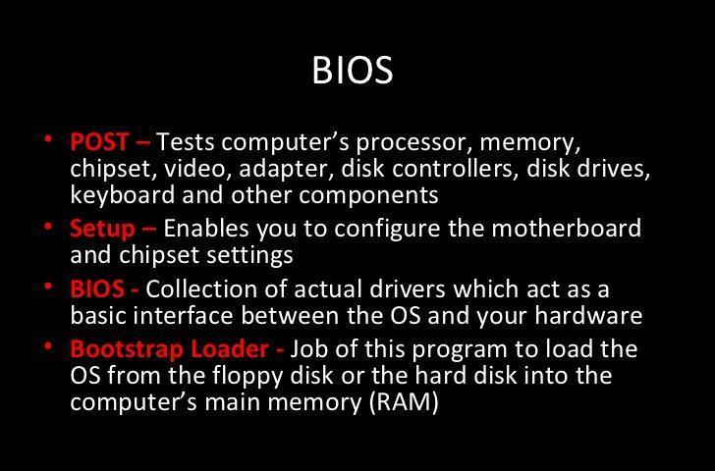

Slide 26
Operating System Concepts

Slide 27
Multiprogramming :
Multiprogramming is a rudimentary form of parallel processing in which several programs are run at the same time on a uniprocessor.
Since there is only one processor, there can be no true simultaneous execution of different programs.
Instead, the operating system executes part of one program, then part of another, and so on.
To the user it appears that all programs are executing at the same time.
Multiprocessing :
Multiprocessing is the coordinated processing of programs by more than one computer processor.
Multiprocessing is a general term that can mean the dynamic assignment of a program to one of two or more computers working in tandem or can involve multiple computers working on the same program at the same time (in parallel).

Slide 28
Multitasking :
Multitasking, in an operating system, is allowing a user to perform more than one computer task (such as the operation of an application program) at a time.
The operating system is able to keep track of where you are in these tasks and go from one to the other without losing information.
Multithreading:
Multithreading is a type of execution model that allows multiple threads to exist within the context of a process such that they execute independently but share their process resources.
Multithreading is similar to multitasking, but enables the processing of multiple threads at one time, rather than multiple processes.
Since threads are smaller, more basic instructions than processes, multithreading may occur within processes.

